Slide 1
Cash Journal
Notes:
©2016 Capgemini. All rights reserved. The information contained in this document is proprietary and confidential. For Capgemini only.

Slide 2
Contents
Cash Journal: Overview
Cash Journal: Configuration
Posting Documents
Important Points
Activity Flow

Slide 3
Cash Journal.
The Cash Journal is a sub ledger of Bank Accounting. It is used to manage a company's cash transactions. The system automatically calculates and displays the opening and closing balances, and the receipts and payments totals. You can run several cash journals for each company code. You can also carry out postings to G/L accounts, as well as vendor and customer accounts.
You should run a separate cash journal for each currency.
You can use the cash journal independently of other posting transactions. You can enter amounts in different currencies. In a two-step procedure, you save the entries in the cash journal before they are transferred to Financial Accounting. After this transfer, the cash journal postings correspond to the FI documents

Slide 4
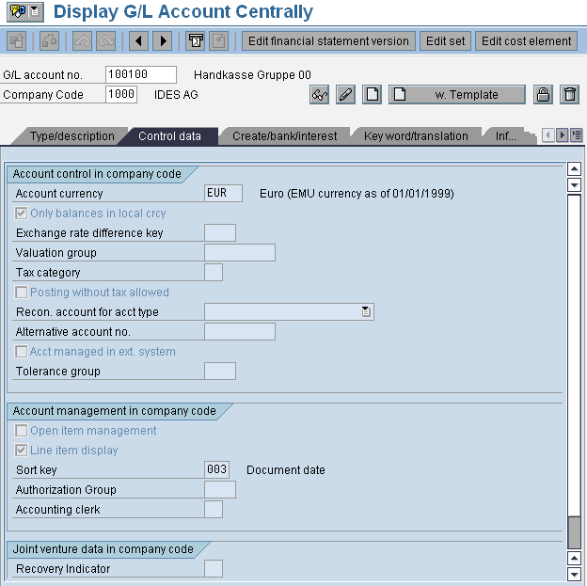
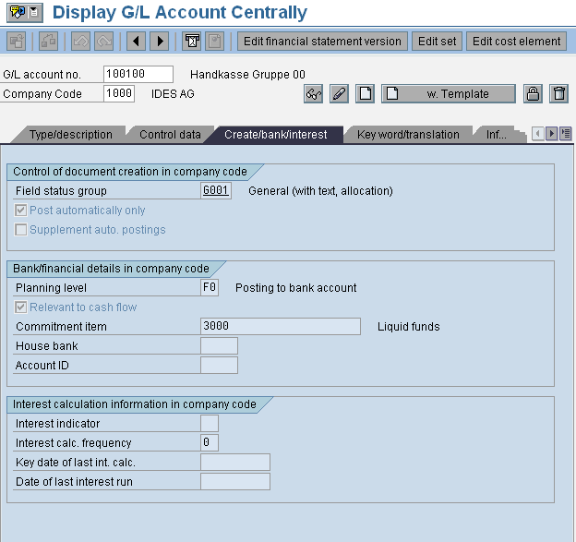
Cash Journal – Configuration.
Create G/L Account for Cash Journal
In this activity, you create a G/L account, for example 100000, for the cash journal in the required company code.
Ensure that the account:
- Can only be posted to automatically
- Displays a unique account currency
If you want to run several cash journals with different currencies in this account, make sure that
- The indicator Balances in local currency only is not set
- The account currency corresponds to the company code currency

Slide 5
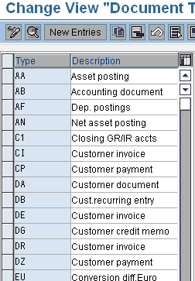
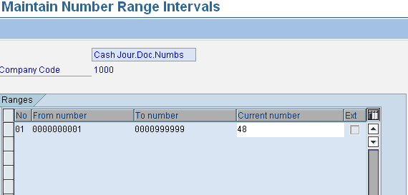
Define Document Types for Cash Journal Documents:
You can select existing document types for cash journal documents, or define new document types in this activity.
You must have document types for the following postings:
G/L account postings
Outgoing payments to vendors
Incoming payments from vendors
Incoming payments from customers
Outgoing payments to customers
Ensure that on the detail screen, the selection fields under Permitted account types, your postings are selected accordingly. Useful selections are for example, account types customer, vendor, G/L account.
Define Number Range Intervals for Cash Journal Documents
You have to define a number range interval for cash journal documents. Each document then receives a unique number that does not clash with the G/L document number.
Determine whether the number range interval 01 has already been predefined by the system. If number range interval 01 has not been predefined, define the interval in the company code required, usually with a document number interval from 1000000000 to 1499999999.

Slide 6
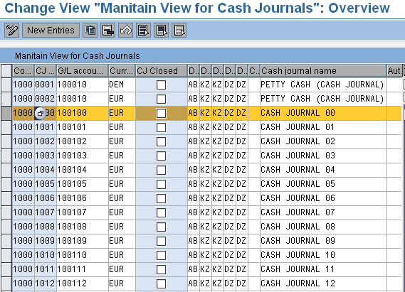
Set Up Cash Journal:
To set up a new cash journal for a company code, enter the appropriate data for the following fields:
Company code
Number: Random number for cash journal identification; You can run several cash journals in each company code.
G/L account to which you want to post the cash journal business transactions, usually the petty cash account.
Currency in which you want to run the cash journal. You are free to choose the cash journal currency. If you want to run a cash journal whose currency does not correspond to that of the company code, you have to consider the following details in the corresponding cash journal G/L account master data:
- The indicator Balances in local currency only should not be set
- The account currency must correspond to the company code currency.
You can run several cash journals with different currencies in one cash journal G/L account. Several cash journals with the same currency in one G/L account is however not possible.

Slide 7
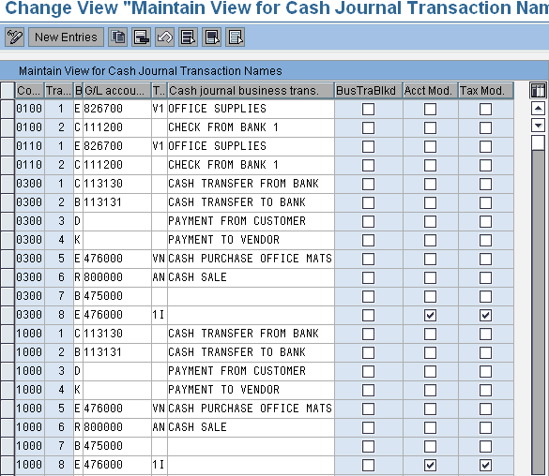
Create, Change, Delete Business Transactions:
In this activity, you can create, change, and delete business transactions for the cash journal. Enter the appropriate date for the following fields:
The company code in which the business transactions should be created.
Business transaction number. Random number that uniquely identifies the business transaction (these numbers are automatically assigned by the system)
Business transaction type
E (Expense)
R (Revenue)
B (Cash transfer cash journal to bank)
C (Cash transfer bank to cash journal)
D (Customers-incoming/outgoing payment)
K (Vendors-outgoing/incoming payment)
G/L account: Expense or revenue account for the offsetting postings of G/L account postings, for example 400000 or 800000. Caution: You must not make entries in the fields for business transaction types D and K.
Tax code: Determines the business transaction control. Caution: You may only make entries in this field for business transaction types E and R.
Cash journal business transaction: Random, automatic language-dependent indicator for the business transaction, for example, SAP Shop or Taxi.
Business transaction block Indicator: Indicates the business transaction is blocked for additional postings.

Slide 8
Posting Documents in the Cash Journal
To get to the cash journal document entry screen, proceed as follows from the SAP R/3 screen: Accounting ➔ Financial Accounting ➔ General Ledger ➔ Document Entry ➔ Cash Journal Posting or Banks ➔ Incoming or Outgoing ➔ Cash Journal.
Enter a company code and a cash journal number.
You can run several cash journals in one company code, but you cannot assign one cash journal to several company codes.
The system notes your entries and user settings.
Depending on what entries you want to make, select either the Receipts or Payments tab.
Enter a business transaction, an amount, and depending on the business transaction, either a customer or a vendor. These are required entries. The other fields are optional entry fields.
Choose Enter to make the cash journal entry.
Choose Save to save the cash journal entry.
Choose Post to post the cash journal entry..
Result: The document has been posted in the cash journal.

Slide 9
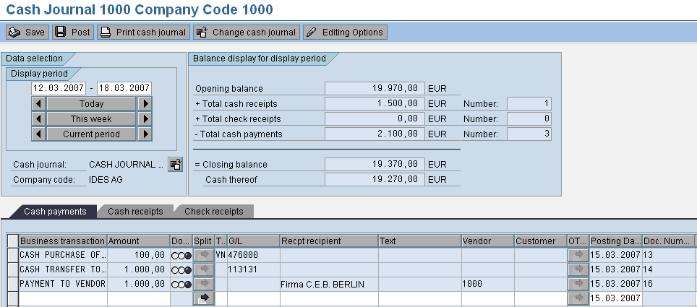

Slide 10
Cash Journal
Important points
The cash journal is a subsidiary ledger in Bank Accounting to manage cash transactions within the organization. It can be used independently of other posting transactions.
The opening and closing balances, as well as the cash receipts and expenditures, are automatically recorded and displayed.
Multiple cash journals can exist within each company code.
Create a separate cash journal for each currency
Post to customer, vendor, and general ledger accounts
Choose a random number for cash journal identification (a four-digit alphanumeric key)

Slide 11
Cash Journal
You have the following options:
Entering, saving, and posting cash journal entries
You can save cash journal entries locally in the cash journal. The system also calculates the balances. The cash journal entries saved are then posted to the general ledger.
For a cash journal document, you can carry out CO account assignments, and have taxes, including withholding taxes, calculated by the system with reference to business transactions, taking account of tax jurisdiction codes, for example.
You can also display the follow-on documents arising for the cash journal entries posted.
As well as defining cash journal business transactions in Customizing
Printing the cash journal
Printing receipts
Displaying all cash journal documents that have been deleted

Slide 12
Cash Journal Activity Flow

Slide 13
Cash Journal
You can define new business transactions for the cash journal in two places:
In the cash journal itself or
In the Implementation Guide (IMG).
To create a business transaction, following settings to be made:
The company code in which the business transaction should be created
The type of business transaction.
Specify tax codes for the business transactions E (Expense) and R (Revenue)
For business transaction categories E, R, C, and B, you can set an indicator to enable the general ledger account for the business transaction to be changed when the document is entered. In this case, the general ledger account is only a default value.
For business transaction categories E and R, you can set and indicator to enable the tax code for the business transaction to be changed when the document is entered. If no tax code has been defined, you have to specify one (if required for the account) when you create the document.
Once saved, the business transaction is assigned a number automatically.
During document entry, the business transaction can be called up by its name or its number.
You can set an indicator that blocks the business transaction for further postings.

Slide 14
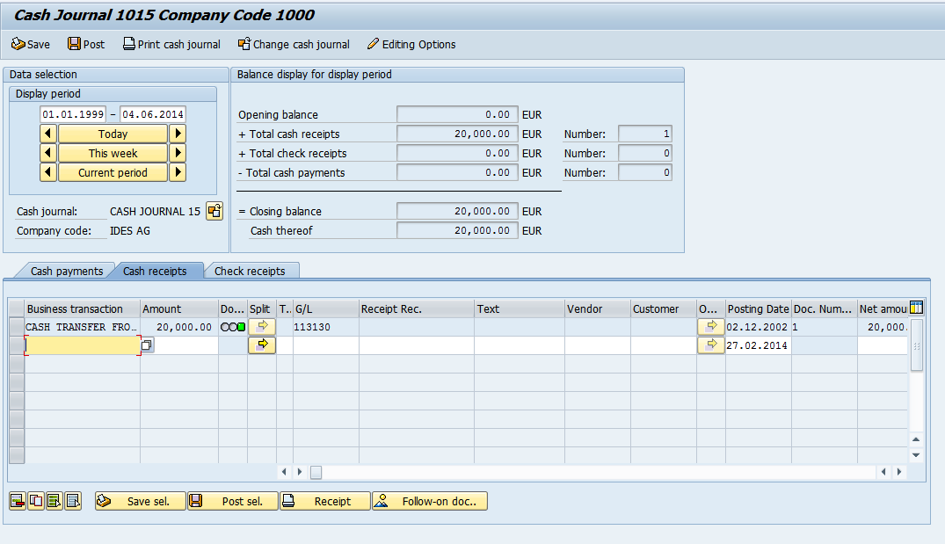
Cash Journal Enjoy Transaction Screen:

